Slide 1
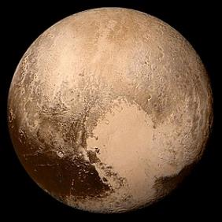
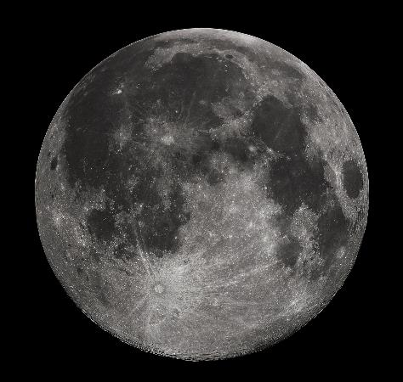
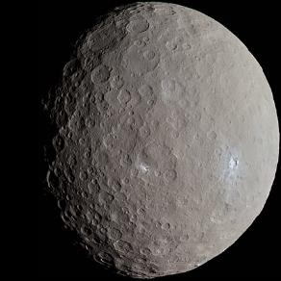
National Science Olympiad
2019 B Division Solar System Event
Earth’s Moon and Rocky Solar System Bodies
Notes:
Notes

Slide 2
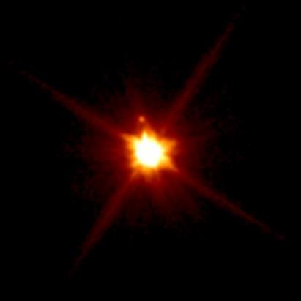
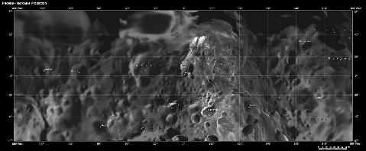
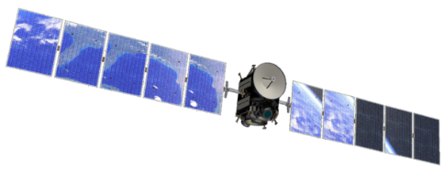
National Solar System Event
DESCRIPTION: Students will demonstrate an understanding and knowledge of the geologic characteristics and evolution of the Earth’s moon and other rocky bodies of the solar system.
Notes:
This is the second year for Solar System in the B Division astronomy event rotation; in 2017 the B Division astronomy event was Reach for the Stars. The focus of this year’s Solar System event is Earth’s moon and other rocky bodies of the solar system. Each team may bring two 8.5” x 11” two-sided pieces of paper containing information in any form from any source for use during competition. The notes may be used during all parts of the event. This year, the event is divided into three sections: general knowledge on the geologic history of rocky solar system bodies, identification of specific bodies within our solar system (with emphasis on natural satellites, dwarf planets, and asteroids), and interpretive tasks including image interpretation, satellite mission identification, and simple calculations of orbital motion

Slide 3
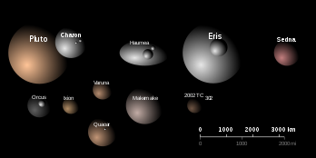
2019 Solar System Part A
Participants must be knowledgeable about the history and geologic processes involved in the formation and evolution of Earth’s moon and other rocky bodies of the solar system.
Notes:
Part A of Solar System states that students be knowledgeable on a range of information regarding the geologic history of Earth’s moon and other rocky bodies in the solar system. Students should be familiar with the history of both entire objects and hypotheses regarding their formation as well as the geologic history and the formation of different geologic surface features. Students should understand what internal and external factors contribute to the evolution of the surfaces of these objects and be prepared to compare and contrast these characteristics.

Slide 4
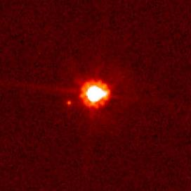
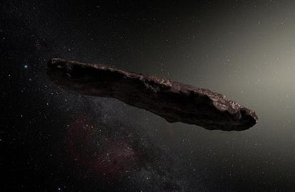
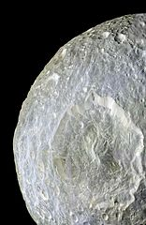
2019 Solar System Part B
Dwarf Planets – Pluto & Charon, Ceres, Haumea, Makemake, Eris
Natural Satellites – The Moon, Mimas, Phoebe
Asteroid Belt Objects, Trans-Neptunian Objects, & Trojans, Including ‘Oumuamua and (225088) 2007 OR10)
Notes:
Part B of Solar System asks students to be knowledgeable regarding the topics listed in Part A in specific application to the above objects in our Solar System.
Haumea → how-MAY-uh
Makemake → MAH-kay-MAH-kay
‘Oumuamua → Oh-moo-uh-moo-uh

Slide 5
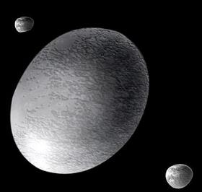
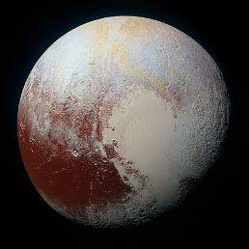
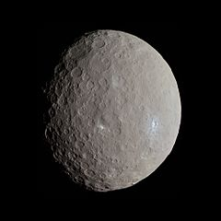

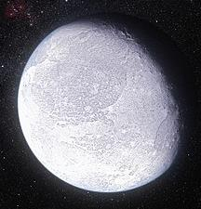
Dwarf Planets: Pluto, Ceres, Haumea, Makemake, Eris
Notes:
The dwarf planets included in the 2019 Solar System event are Pluto, Ceres, Haumea, Makemake, & Eris. Students should be familiar with the internal, surface, and atmospheric composition and evolution of these objects, with a focus on their geologic properties. Distinctions between formal terrestrial planets and smaller dwarf planets will be relevant, particularly in comparing the otherwise similar geologies of dwarfs and terrestrials.

Slide 6
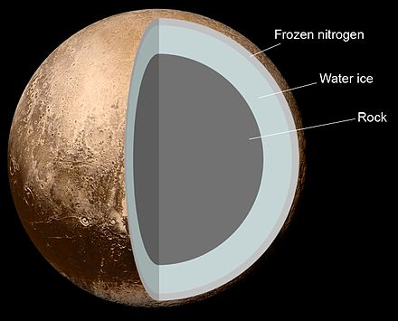
Pluto: Internal Structure
Notes:
Pluto is the largest dwarf planet in the Solar System by volume, but still not large enough for the big leagues. It was first discovered in 1930 by Clyde Tombaugh and was the first identified object in what is now called the Kuiper Belt. It is about 1/6th the mass of Earth’s moon and composed primarily of ice and rock. Interestingly, Pluto’s orbit is fairly eccentric, especially in comparison to other Solar System bodies, such that for portions of its orbit it is closer to the Sun than Neptune, the furthest planet in the Solar System

Slide 7
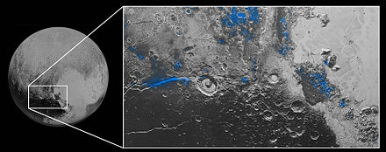

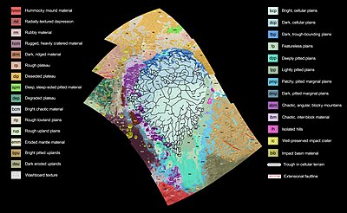
Pluto: Surface Characteristics
Notes:
Pluto’s surface geology is dominated by massive plains (or “planitia”) of nitrogen ice, such as the Sputnik Planitia, the western lobe of the now-famous “Heart”. The dark spot immediately to the southeast of this heart is known as the Cthulu Macula, or simply “the Whale” due to its complete shape. It is thought to be so darkly contrasting as a result of complex hydrocarbons populating the surface geology known as tholins. These compounds are of particular importance for their potential as a prerequisite for life.

Slide 8
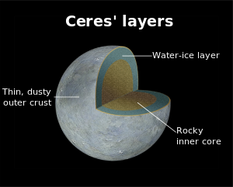
Ceres: Internal Structure
Notes:
Ceres is the largest object in the asteroid belt and the closest dwarf planet to Earth, as well as one of just a few within Neptune’s orbit. It orbits between Mars and Jupiter and was predicted to exist as early as 1772, but was not discovered until about 30 years after that. It is very similar in composition and surface geology to the asteroids it shares a neighborhood with, and for a long was classified as such; today, however, it is principally recognized as a dwarf planet.

Slide 9
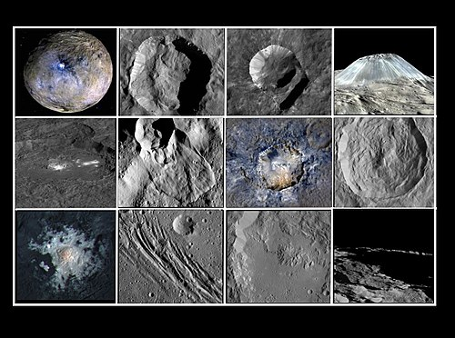
Ceres: Surface Characteristics
Notes:
Ceres is a very geologically diverse body, as the small collection of images above demonstrate. It bears resemblance to several moons of Saturn (Rhea, Tethys), as well as C-Class asteroids, further adding to its hazy status as a asteroid-turned-dwarf. Its surface temperature is very high, contributing to a lack of ice cover and subsequently low albedo. It has a large internal layer of water ice, more in fact than the volume of freshwater on Earth. It is also well known for its faculae – bright surface features likely composed of magnesium salt brine and ammonia – and large montes, including Ahuna Mons, a prominent mountain with unclear origin.

Slide 10
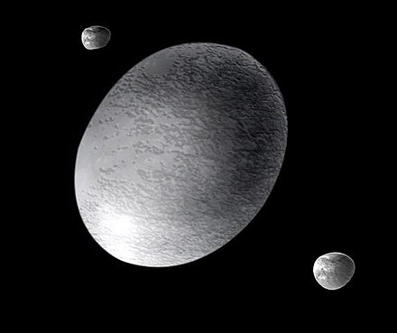
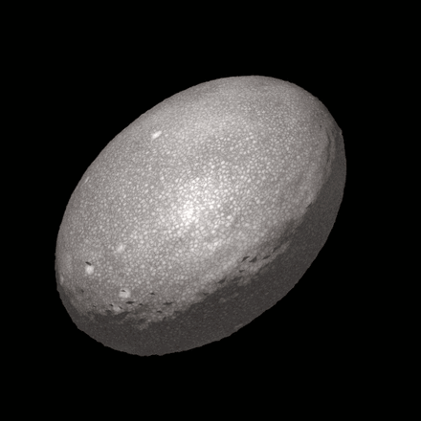
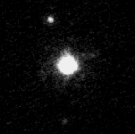
Haumea
Notes:
Haumea is a dwarf planet beyond the orbit of Neptune. Discovered in 2004 at Palomar Observatory, it is a rotationally-flattened ellipsoid and one of the largest Trans-Neptunian Objects, despite being 1/1400 the mass of the Earth. Obviously, the most striking characteristic of this dwarf planet is its ellipsoidal shape, twice as wide along its major axis as its minor. This is thought to be the result of a giant collision at the time of its formation, which also created its moons, Hi’iaka and Namaka. It’s axial rotation period is a blistering 3.9 hours, the fastest of any equilibrium object in the Solar System and faster than any other object larger than 100km in diameter.

Slide 11
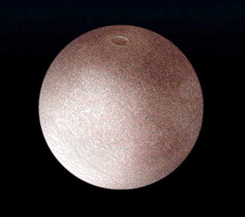
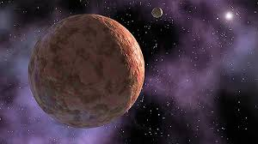

Makemake
Notes:
Makemake is one of the largest known Kuiper Belt objects, first discovered in 2005. Interestingly, it is comparable in apparent brightness to Pluto, meaning that it could have been detected as early as the 1930s alongside Pluto were it not aligned with the dense stellar background of the Milky Way at the time. Like Haumea, Makemake also has an abnormally fast rotation period at 7.7 hours. It is completely lacking in atmosphere, originally attributed to the ease with which gas can escape from its gravitational pull but now thought to be more complicated. Makemake is also significant for being one of two objects (the other being Eris) which prompted the International Astronomical Union to reconsider the definition of “planet” and eventually get Pluto demoted.

Slide 12
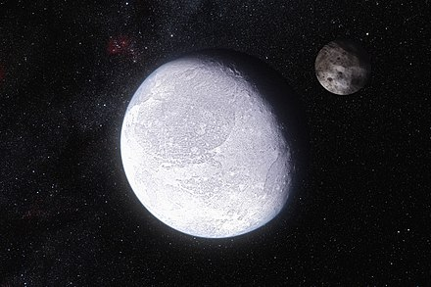
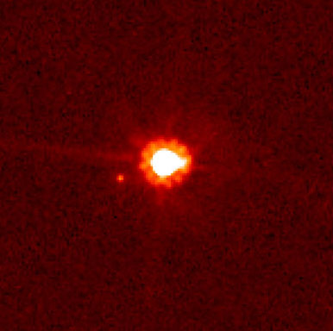
Eris
Notes:
Eris is the most massive dwarf planet in the Solar System and second-largest by volume, discovered in 2005 by Palomar. Like Makemake it is Trans-Neptunian, and has a highly inclined orbit as compared with the rest of the Solar System, tilted almost 45 degree with respect to the ecliptic. It is so distant from the Sun at aphelion that its atmosphere freezes and falls to its surface like snow, only to thaw as it draws closer to the Sun. Due to its distance and size, very little it known about the surface of Eris, and there are currently no plans made public to send a probe out to explore it or its single moon, Dysnomia.

Slide 13
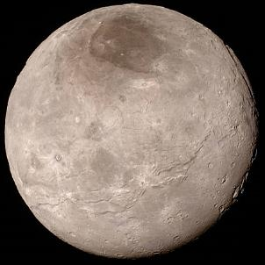
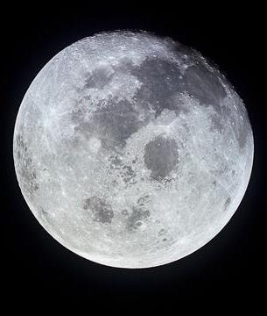
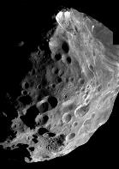
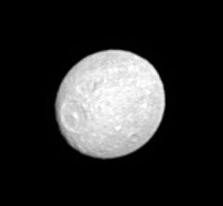
Natural Satellites
Notes:
The major satellites that are included in the 2019 version of Solar System are those large rocky satellites that have dynamic and very different surface geologies, as well as fascinating histories of formation and evolution. The satellites included in this year’s version of the rules are Earth’s Moon, Saturn’s moons Mimas and Phoebe, and Pluto’s moon Charon

Slide 14
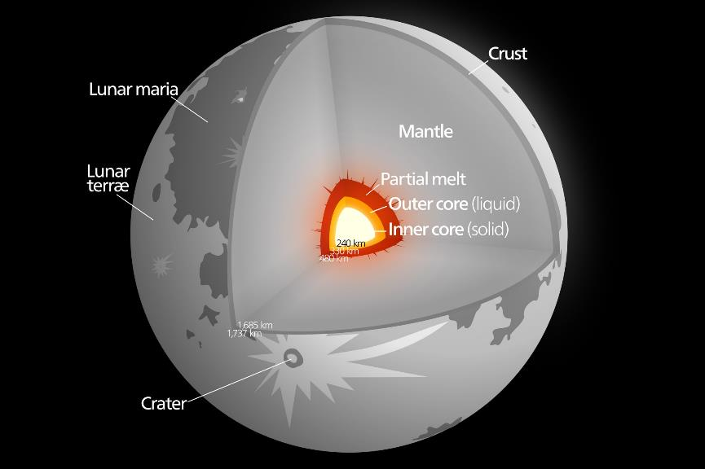
The Moon: Internal Structure
Notes:
The Moon has a differentiated internal structure, a fact that was surprising to many scientists given its size, composition, and distance from the Sun. Many scientists believe that a large impact early in the Moon’s history provided the necessary heat for the differentiation and the emergence of a plagioclase-rich or “lighter” crust atop a mafic mantle. “Moonquakes”, the equivalent of Earthquakes on the moon, are caused not by tectonics but rather from thermal expansions and contractions as the moon rotates and continues to cool internally, as well as from tidal stresses caused by Earth.

Slide 15
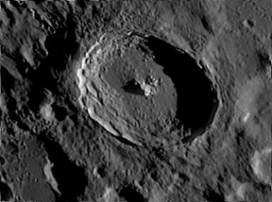
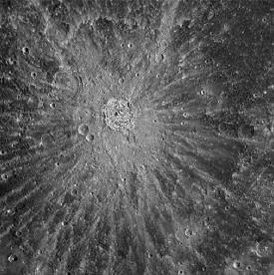
The Moon: Surface Characteristics
Notes:
You may have heard people reference “The dark side of the moon” or the side of the moon we never see from Earth. The moon is tidally locked with Earth, meaning the same side always faces Earth and has a synchronous orbit, meaning its rotation period and orbital period are the same. The geology of the Moon, the study of which is called selenology, is characterized primarily by cratering and volcanism. Features known as Highlands, dark plains called Maria, and rilles, domes, and grabens are also found on the moon. There are many more craters on the far side of the Moon than the near side, as it is exposed to bombardment coming towards the Earth-Moon system.

Slide 16
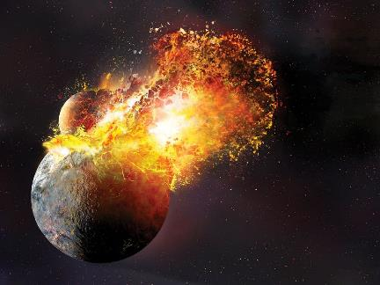
Formation and History of the Moon
Notes:
The formation of the moon has long presented questions to scientists, as the Moon is the largest satellite relative to its host planet in the solar system. One of the most favored explanations of the formation of the moon is called the “giant-impact hypothesis” and poses that the moon was created when a large body collided with Earth, breaking off a significant amount of material that then coalesced in orbit around Earth.

Slide 17
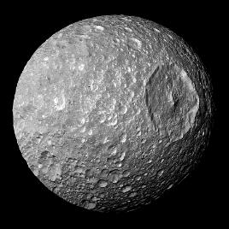
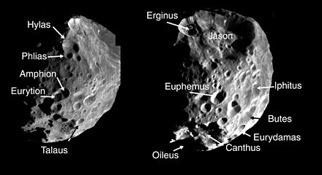
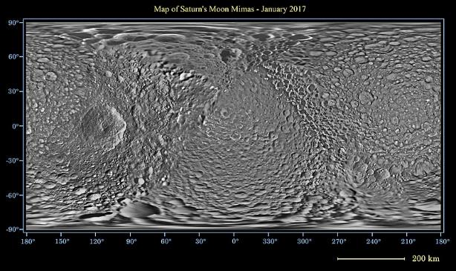
Saturn’s Moons Mimas and Phoebe
Notes:
Mimas and Phoebe are both rocky satellites of the planet Saturn. They have both been known to exist since before the 20th century, although it was some time before they could be resolved enough to discern major surface characteristics. Mimas’s total surface area is approximately that of Spain’s, and it is dominated by the 81-mile diameter crater Herschel, named for the moon’s discoverer, William Herschel (a crater of comparable scale on Earth would be the size of Australia). Mimas is also the smallest body currently found to be rounded by its own gravity, in contrast to the highly irregular Phoebe. Phoebe was a major target for the Cassini mission to Saturn, and it was battered out of roundness in the early years of its formation by repeated massive impacts. It orbits retrograde to Saturn, about once every 18 months, and is thought to be a captured icy Kuiper belt object.

Slide 18
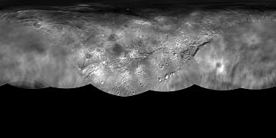
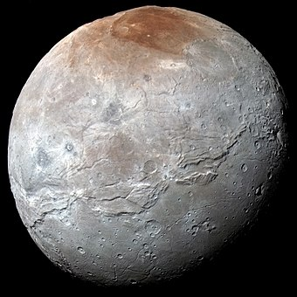
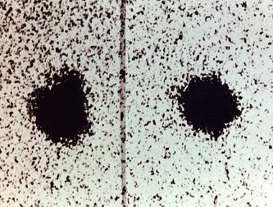
Pluto’s Moon Charon
Notes:
Charon is the largest moon of Pluto, and has the largest satellite:planet size ratio in the Solar System, at about half the diameter of Pluto. Charon is so large in comparison to Pluto that it does not even directly orbit the planet; both objects orbit a common barycenter that lies between them in space. Geologically, Charon is not well understood, and there are currently two theories regarding its internal structure; either that it is mostly rocky with a water-ice subsurface layer, or nearly entirely water-ice throughout with a very thin overlying rock-ice crust. Regardless of its interior, Charon is dominated by water-ice on its surface, particularly around its low latitudes. The poles, in contrast, display a deep red coloration, thought to be the result of condensed gases from Pluto’s atmosphere. These gases for an ice compound that, when subjected to solar radiation, produce the compound tholin, a potentially necessary ingredient for life.

Slide 19
The Asteroid Belt, TNOs, and Trojans
Notes:
The final important geologic bodies in the solar system are the main asteroid belt, trojan asteroids, and the Trans-Neptunian Objects.

Slide 20
The Asteroid Belt
Notes:
The asteroid belt contains hundreds of thousands of small rocky bodies that were unable to condense into a planet under the gravitational influence of Mars and Jupiter. The Asteroid Belt’s “Kirkwood Gaps” occur at distances between Mars and Jupiter where no gravitationally stable orbits exist.

Slide 21
The Asteroid Belt
C-type
M-type
S-type
Notes:
There are 3 main types of asteroids, characterized by composition and appearance. C-type or carbonaceous asteroids are rich in carbon and have low albedo, meaning they are very non-reflective. C-type asteroids more prevalent in the outer regions of the asteroid belt. S-type or silicate asteroids are composed primarily of silicates, indicating the presence heating and reformation after their initial formation, which contributed to their relatively high albedo. These asteroids are more common towards the inside of the asteroid belt. M-type or metallic asteroids make up only 10% of all asteroids in the belt, and are composed primarily of iron and nickel. It is unknown how M-type asteroids were formed, and many believe that they may be the cores of differentiated progenitor bodies that were later broken up.

Slide 22
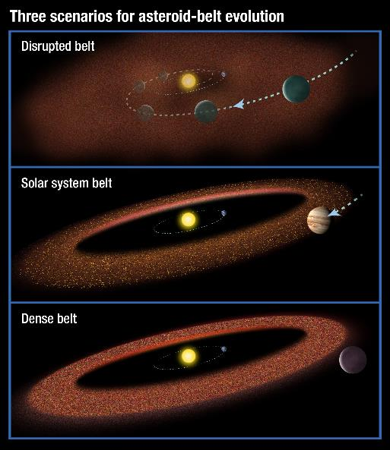
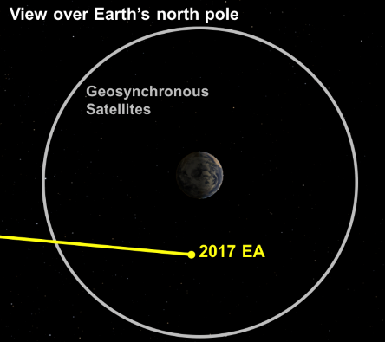
Formation of the Asteroid Belt and Near Earth Asteroids
Notes:
The asteroid belt was formed early in the solar system’s evolution between Mars and Jupiter, where some scientists believe a small planet originally orbited that was then gravitationally destructed by the pull of Mars and Jupiter. Over time, many asteroids were consumed by Jupiter or gravitationally ejected from the solar system, leaving the total mass of the asteroid belt at less than 5% that of the moon. Most Near Earth Asteroids are asteroids that were ejected from the main asteroid belt due to gravitational interactions with Jupiter, while some are extinct comets caught in smaller orbits around the sun.

Slide 23
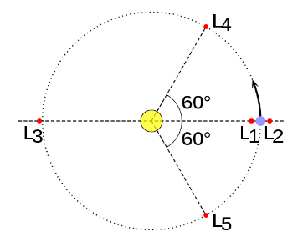
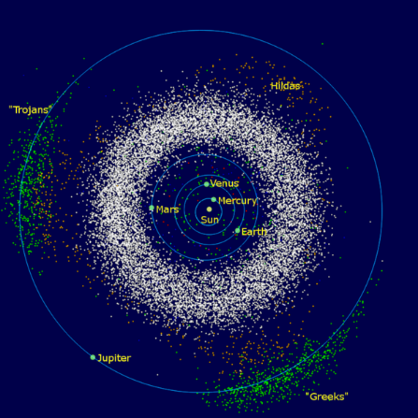
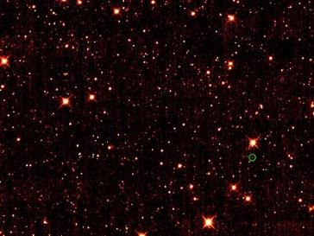
Trojan Asteroids
Notes:
The trojan asteroids are a separate population which orbit along the same path as Jupiter, approximately within its 4th and 5th Lagrangian points. “Trojan” can also refer in general to an asteroid which shares an orbit with a planet. The Jupiter trojans include two separate populations, the Greek and Trojan camps, in its L4 and L5 points respectively. They account for the majority of Trojans in the Solar System (over 1 million for Jupiter alone), though such asteroids have been found for Mars, Neptune, and yes, even Earth has one.

Slide 24
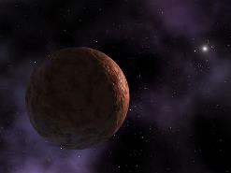
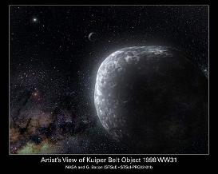
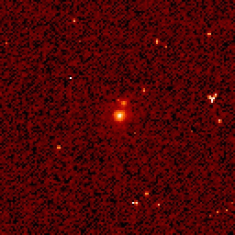
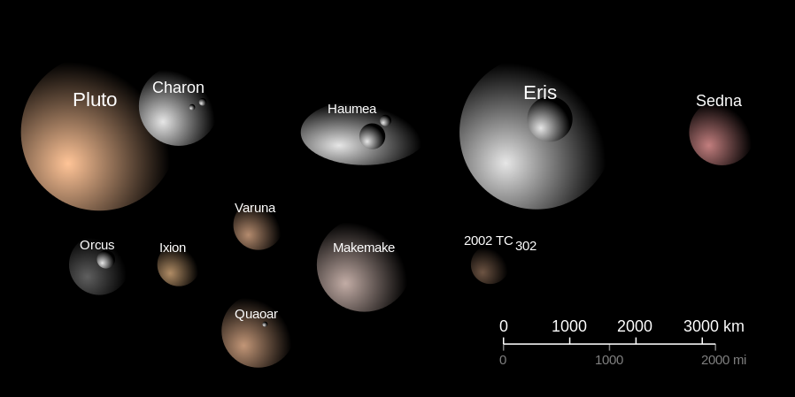
Trans-Neptunian Objects
Notes:
Finally, the Trans-Neptunian Objects , or TNOs, refer to any minor plant which exists outside the orbit of Neptune in our Solar System. Over 2300 of these objects are known to exist, and the most massive are Pluto, 2007 OR10, Makemake, and Haumea. These objects are very hard to study due to their extreme distances coupled with very dim apparent magnitudes, so almost everything we know about them comes from their thermal emissions and spectral data. Even this is unreliable, since many of these objects are thought to have a layer of regolith beneath the thin surface exposed to solar radiation. In addition, even the thermal radiation we detect in them is limited to observations outside the Earth’s atmosphere. However, there are still a few of these objects we’ve managed to learn a bit about.

Slide 25
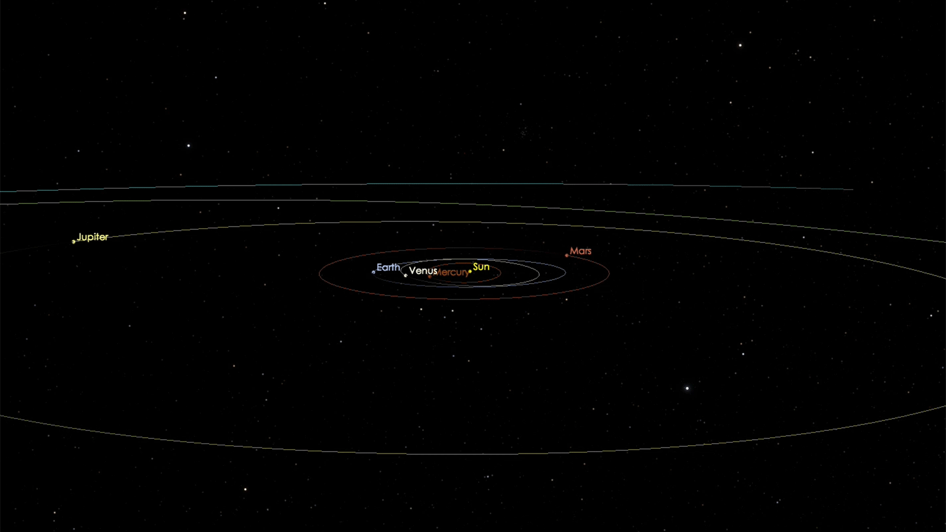

‘Oumuamua
Notes:
‘Oumuamua is an active comet and the first known interstellar object to pass through the Solar System. It is uncharacteristic of most comets due to its lack of a tail, extreme oblong shape, high metallicity, lack of ice, and extreme speed, though its acceleration boost in passing away from the Sun is consistent with comet outgassing. Due to all these compounding factors, however, it is theorized that ‘Oumuamua originated from far outside the Solar System. As it travels further from the Sun, it will begin to slow down, so it will take approximately 20,000 to exit the Solar System completely. Still, it is moving so fast that any satellite mission to it would be nearly impossible. Its system of origin and the time it has spent travelling through space remain completely unknown.
Graphic is a light curve

Slide 26
2019 Solar System Part C
Participants will be asked to complete one or more hands-on or interpretive tasks selected from the following topics:
i. Geologic history & formation of features and objects
ii. Remote sensing, imagery, and satellite measurements of features above as well as entire bodies
iii. Missions: New Horizons, Dawn, Cassini, Lucy, Voyager 2
iv. Kepler’s laws, Gravitational effects of the Moon, and Tides
v. Rotation, libration, phases, and eclipses
vi. Surface dating, regolith, volcanism & weathering, cratering & impact processes
vii. Internal, surface, and atmospheric composition
Notes:
Part II of the 2018 Solar System event tests students’ knowledge of the history and observation of physical and geological processes through both qualitative and quantitative understandings. This part of the exam may include calculations, questions involving real data, as well as diagrams and maps. Questions that fall under this section of the rules may be paired with questions from Part I.

Slide 27
Formation of the Solar System
Notes:
The formation of the Solar System as is pertinent to its geologic bodies may also be tested in this event, primarily focusing on the distribution of different substances around the Sun during the condensation of the protoplanetary disk, the large cloud of dust that condensed around the Sun early in its formation. This describes the most popular of Solar System formation theories, and is known as the “Nebular Hypothesis”

Slide 28


Remote Sensing and Surface Imagery
Radar Altimetry
Curiosity Rover ChemCam
Principles of Spectrometer
Notes:
Students may be asked questions about remote sensing and imagery as related to measuring and observing the objects in Part I especially their geologic features. Exams may test students’ understanding of why specific wavelengths or specific types of measurements are used for different objects, as well as the roles that object mass, surface, atmosphere, or location play in determining our ability and strategy in studying these objects. Tests may include questions about different kinds of telescopes and instrumentation, including Earth-based or Earth-orbiting observatories as well as missions to the objects themselves. Example types of remote sensing that could be asked about are radar altimetry, spectroscopy, imaging in different regions of the electromagnetic spectrum, and gravity sensing.

Slide 29





Major Satellite Missions
Lucy
Cassini-Huygens
New
Horizons
Voyager 2
Notes:
This year, the Solar System event will deepen its focus from “any past, present, or future” satellite missions to a more in-depth look at five: Dawn, Lucy, Cassini-Huygens, New Horizons, and Voyager 2. Dawn launched in 2007 to explore Ceres and Vesta, and has been orbiting the former since March 2015. Lucy is a planned space probe that will launch in 2021 to examine five Jupiter trojans, appraising their potential to host early remnants of planet-forming material. Cassini-Huygens launched a week after I was born, in October 1997, to explore Saturn and its system, completing its mission this past September. New Horizons launched in 2006 to explore Pluto, making its flyby in 2015 and now heading towards the outer Kuiper Belt. Voyager 2 launched in 1977 to explore the gas giants, and is currently hurtling away from Earth at over 55,000 km/h on a trajectory to leave the Solar System completely by 2020, maintaining communication with Earth until 2025 and reaching the star Sirius around 298,000 AD.

Slide 30
Kepler’s 1st Law
The orbit of a planet is an ellipse with the Sun at one of the two foci.
Notes:
Students are expected to have both a quantitative and qualitative understanding of Kepler’s Laws of Planetary motion, and should be able to recognize these laws in words, equations, or pictoral form as well as perform calculations using real data. Kepler’s 1st law: The orbit of a planet is an ellipse with the Sun at one of the two foci. Students are not required to be familiar with the complete geometry of an ellipse, but should understand the basic principles of its construction and the relationship between perihelion (the distance of closest approach to an object), apehelion (the distance of further approach), semimajor axis (the average of perihelion and apehelion distance), and eccentricity (the variance of an orbit from circular).

Slide 31
Kepler’s 2nd Law: “The Law of Equal Areas”
A line segment joining a planet and the Sun sweeps out equal areas during equal intervals of time.
Notes:
Kepler’s 2nd law, or “the law of equal areas”: A line segment joining a planet and the Sun sweeps out equal areas during equal intervals of time.

Slide 32
Kepler’s 3rd Law: “The Harmonic Law”
T² ~ a³
The square of the orbital period of a planet is proportional to the cube of the semi-major axis of its orbit.
Notes:
Kepler’s 3rd law: The square of the orbital period of a planet is proportional to the cube of the semi-major axis of its orbit. This may be expressed as “P squared is proprtional to A cubed”. Students should be comfortable using this relation with units of Astronomical Units for distance and Years for period for objects orbiting the Sun, but need not be familiar with the role that mass plays for using Kepler’s third law in systems outside our own solar system.

Slide 33
The Moon and Tides
Notes:
Exams may include questions about tides, specifically regarding the Earth-Moon system. Tides are caused by changes in the relative positions of the Moon and Earth and the gravitational bulges created by the Moon’s gravitational tug on Earth. Students should understand why different parts of the world experience different tidal patterns at different times of day. Students should be familiar with Neap Tides and Spring Tides, which occur when the gravitational forces due to the Sun and the Moon are perpendicular and parallel, respectively.

Slide 34


Solar Eclipses
Total Solar Eclipse
Annular Solar Eclipse
Notes:
Students should understand and be able to identify eclipses both from diagrams of the Sun, Moon, and Earth and as observed from Earth. Solar eclipses occur when the Moon passes in front of the Sun as viewed from Earth, blocking all but the outermost regions. Total solar eclipses occur when the entire face, or photosphere, of the sun is blocked, whereas annular solar eclipses occur when the moon is further from Earth and its projection does not fully eclipse the sun.

Slide 35

Lunar Eclipses
The Moon during a Lunar Eclipse is illuminated only by sunlight refracted around the Earth
Notes:
Lunar eclipses occur when the Earth completely blocks the Sun from illuminating the moon, allowing only the outermost light from the sun to shine red on the face of the moon when it is refracted around Earth.

Slide 36
Phases of Earth’s Moon
Notes:
The phases of the moon and what causes them are also included in Part II. The lunar cycle and the relationship between the phase of the moon and what time the moon rises and sets each day may also be tested. For example, this diagram shows a full moon among other phases. Students can infer based on the position of the Sun, Moon, and Earth that a full moon rises in the evening, reaches its highest point in the night sky at midnight, and sets in the morning.

Slide 37




Regolith in the Solar System
Mars Regolith
Moon Regolith
Venus Regolith
Asteroid Regolith
Notes:
Regolith is a general name for the fine material that makes up the surfaces of geologic bodies in the solar system. Students should be familiar with processes like weathering and cratering that generate regolith on the surface of these bodies as well as the composition of regolith, including whether or not it varies across the surface of the object and how scientists determine its composition.

Slide 38


Cratering in the Solar System
Notes:
Cratering is one of the most significant processes in the solar system with regards to shaping the surfaces of rocky bodies. The size and age of different craters can inform scientists about when and where significant cratering events, such as the Late Heavy Bombardment, occurred in the history of the solar system. Lack of craters, such as the surface of Io exhibits, can inform scientists as to how fast new surface material is being generated.

Slide 39




Volcanism and Weathering
Notes:
Volcanism and weathering are two important geologic processes that shape and recycle the surfaces of geologic bodies in the solar system. Volcanism on Venus, Mars, and Io may be compared and contrasted. Weathering from atmospheric dynamics or fluid flows on the surfaces of the objects specified in Part I may also be included. The atmospheres of the objects included in Part I of this event are important both in contributing to the surface characteristics of the objects and in determining how scientists can study them. Different atmospheric compositions, temperatures, and dynamics determine which wavelengths of light and what methods of remote sensing can be used to study the surfaces of different objects.

Slide 40


Surface Dating and Radioactive Isotopes
Notes:
Dating the surface of geologic bodies of the solar system is essential to understanding the history of these bodies and determining the frequency, intensity, and nature of the internal and external features that have contributed to the geologic evolution of the surfaces of these bodies. Radioactive dating allows scientists to determine how much of specific isotopes remain in the surface features of these bodies, which may have been present in the atmospheres or surfaces of these objects in different quantities in the past compared to the present. Radioactive dating uses the formula shown, where A represents the current concentration of an isotope, A naught represents the concentration of the isotope present a number of years ago, t represents the age of the feature, and h is a constant or the “half-life” of that isotope that indicates how long it takes for one half of the total atoms of an isotope present to decay. Students do not need to understand the origin of this formula, but should be familiar with the idea of isotopes – versions of atoms with different numbers of neutrons – and radioactivity – the decay of these atoms into other atoms over time.

Slide 41





2019 Solar System Event Example Exam & Event Resources
NASA Planets
JPL Planetary Geophysics
NASA Asteroids
NASA Space Place Eclipses
NASA Moon
Notes:
The example exam, along with an annotated version, will be posted on the Solar System Division B Page on the National Science Olympiad event website. The annotated version of the exam can be used by coaches and event supervisors to understand the kinds of questions and test formats that are most appropriate for this exam, as well as the appropriate length and difficulty for a typical solar system exam. Students can take the unannotated version of the exam in preparation for competition this season. A number of helpful resource websites for Solar System 2018 are included at the bottom of the rules sheet for this event. These include the NASA Jet Propulsion Laboratory Planetary Geophysics website, the NASA Planets website, the NASA moon website, the NASA Asteroids website, as well as the NASA Space Place eclipse website.

Slide 42
National Solar System Event Supervisor:
Dustin Schroeder - dschroed@gmail.com
Rules clarifications:
available at www.soinc.org under event information
Event Preparation:
Read the Event Description for content and allowable resources.
Make use of the recommended event resources and websites.
Practice early and often!
Notes:
The national event supervisor for Solar System is Dr. Dustin Schroeder, an assistant professor of geophysics at Stanford University in California. Follow the suggestions provided here to prepare for competition. If you have any questions, please submit them online on the rules clarification website if they involve the event description. Event supervisors are not allowed to answer any individual questions about the event as this would be unfair to others.

